Slide 1



Lists and Tuples: A Comprehensive Guide
Welcome to our guide on lists and tuples. Whether you're a coding novice or an experienced programmer, this presentation will provide an in-depth overview of these essential data types.
by Anik Acharjee

Slide 2

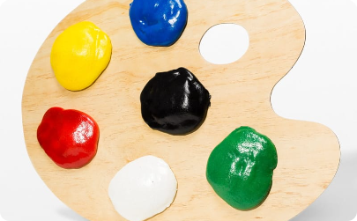


Introduction to Lists
What are lists?
Why use lists?
Where can lists be used?
Lists are an ordered collection of elements, each indexed by an integer. They are mutable and versatile, making them one of the most fundamental data types in Python.
Lists allow us to store and manipulate multiple pieces of related data in a single place. They enable us to perform complex operations on our data with ease.
Lists are used extensively in Python and many other programming languages, and are ideal for everything from simple data storage to advanced algorithms and data science projects.

Slide 3
Accessing Lists
Indexing
Slicing
Access individual elements in a list by their index number.
Get a portion of the list by specifying a range of indices.
Membership testing
Iteration
Check if a particular item is in a list using the "in" keyword.
Loop through all the elements in a list using a "for" loop.

Slide 4
Operations on Lists
1
Concatenation
Combine two or more lists together using the "+" operator.
2
Repetition
Create a new list with repeated elements using the "*" operator.
3
Sorting
Sort a list in ascending or descending order using the "sort" method or the "sorted" function.

Slide 5
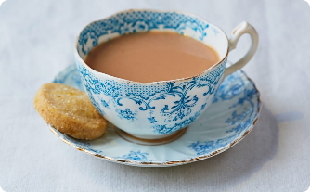

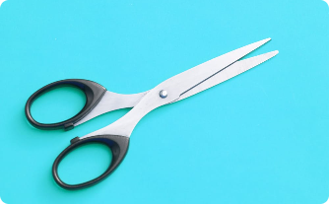
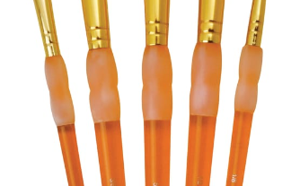
List Methods
append()
remove()
extend()
Add a new element to the end of a list.
Remove the first occurrence of a particular element from a list.
Combine two lists by adding all the items from one list to the end of the other.
insert()
Add a new element to a specific position in a list.

Slide 6
List Comprehensions
What are they?
Why use them?
How do they work?
A concise way to create a new list by applying an expression to each element of an existing list.
List comprehensions are fast, easy to read, and can significantly reduce the amount of code you need to write.
List comprehensions consist of an expression, a for loop, and an optional conditional statement.

Slide 7
Nested Lists
1
What are they?
A list that contains other lists as its elements.
Why use them?
2
Nested lists are useful when dealing with multidimensional data, such as matrices or tables.
3
How do they work?
To access an element in a nested list, specify the index of the outer list followed by the index of the inner list.

Slide 8
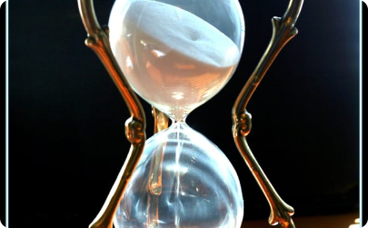


Introduction to Tuples
What are tuples?
Why use tuples?
Where can tuples be used?
Tuples are similar to lists, but are immutable and typically contain a fixed number of elements.
Tuples are often used to represent data that shouldn't be changed, such as database records or the x,y coordinates of a point in space.
Tuples are used in a wide range of programming applications, from scientific computing to web development.

Slide 9
Accessing Tuples, Functions and Methods
Indexing and Slicing
Functions
Methods
Access tuple elements using the same indexing and slicing methods as lists. Because tuples are immutable, you can't change their elements directly.
Many Python built-in functions work with tuples, such as len(), min(), and max().
Tuples have a variety of useful methods, including count() and index().

Slide 10
Operations in Tuples
Tuples are a versatile data type that can be used in many different ways. One of their key features is their ability to perform operations, such as concatenation and slicing. In this card, we'll explore some of the most common operations you can perform on tuples. From accessing individual elements to sorting and searching, we'll cover everything you need to know to get started with tuples.

Slide 11

Exploring Tuples: Common Operations
Tuples are a powerful data type in Python that allow you to store a collection of values. In this card, we'll explore some of the most common operations you can perform on tuples, such as indexing, slicing, and sorting. We'll also cover how to convert tuples to lists and vice versa, and how to use tuples in loops and conditional statements.

